Slide 1

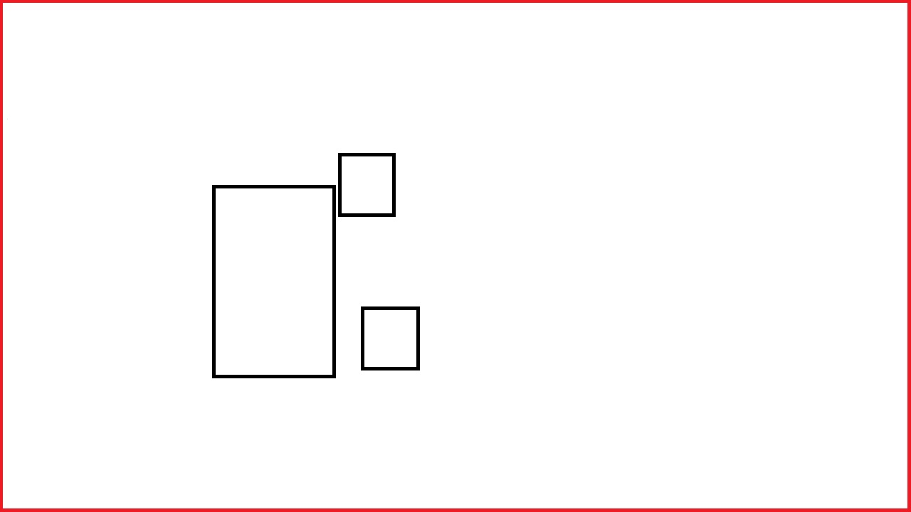


Classification network
RoI Pooling
Proposal regions
Region proposal network
Feature map
Conv

